Slide 1


A Comparative Analysis Of Machine Learning Methods And Building Model For Emotion Recognition From EEG Data
MIT POLYTECHNIC, PUNE
DEPARTMENT OF COMPUTER ENGINEERING
Under the Guidance of : Prepared By :
Prof.H.S.Ohal 1. Suyog Chavan
2. Ritesh Shende
3. Rushikesh Shinde
4. Sanket Pophale
MAHARASHTRA BOARD OF TECHNICAL EDUCATION

Slide 2
CONTENTS
Problem Definition
Technology Used
EEG Signals
Flow Diagram of Project
Eye blink artifact removed (output)
Data-sets Used
Output
Literature Review

Slide 3
PROBLEM DEFINITION
Develop a Project that will help one to a detect Emotion’s using
EEG Data.
The main aim of the project is to detect Emotion’s in the form of
3D graphs and Diagram Plotting Techniques.

Slide 4
TECHNOLOGY USED
Language : Python
Editor : Visual Studio Code
Jupyter Notebook

Slide 5
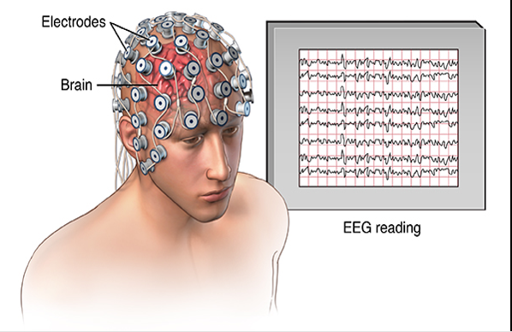
EEG SIGNALS
An Electroencephalogram (EEG) is a test
that detects electrical activity in our brain using
metal disc (electrodes) attached to our Scalp.
Our brain cells communicate via electrical
impulses and are active all time.
This activity shows up as wavy lines on EEG
recording.

Slide 6
FLOW DIAGRAM OF PROJECT

Slide 7
DATA-SETS USED
S001R04.edf ( Loading & visualizing Data )
Link : https://physionet.org/content/eegmmidb/1.0.0/S001/S001R04.edf
A01T.mat ( Cleaning Eyeblinks and Regression )
Link : http://bnci-horizon-2020.eu/database/data-sets
Emotion.csv ( Emotion Recognition by Classifier )
Link : https://www.kaggle.com/datasets/birdy654/eeg-brainwave-dataset-
feeling-emotions

Slide 8
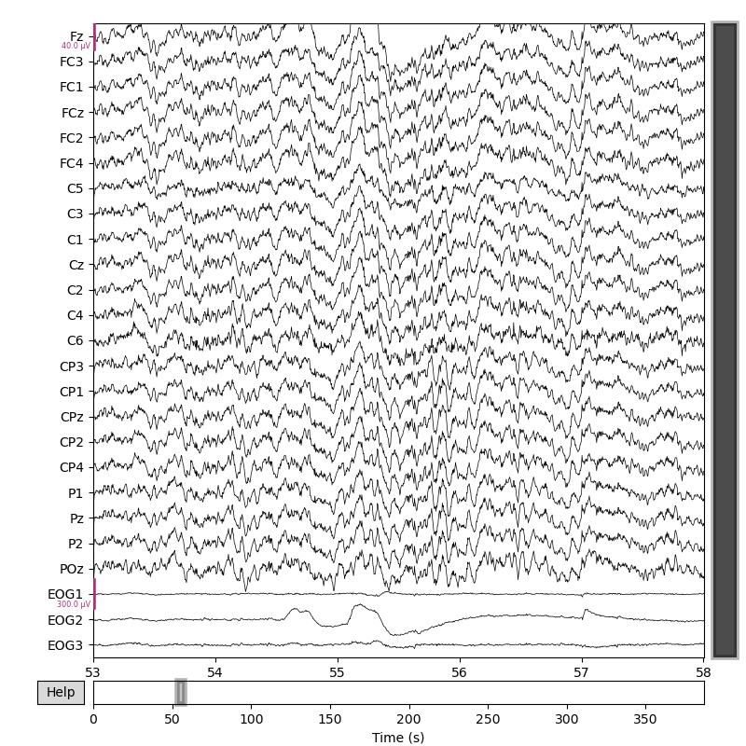

Cleaning the eye blink artifacts (output)
Before
After

Slide 9
LSTM ALGORITHM
Long Short-Term Memory networks are well suited to
classifying , processing and making prediction based on a series data .
It is mainly used in the field of Deep Learning (DL) .
LSTM calculate the average Wall-time and Accuracy of the code

Slide 10
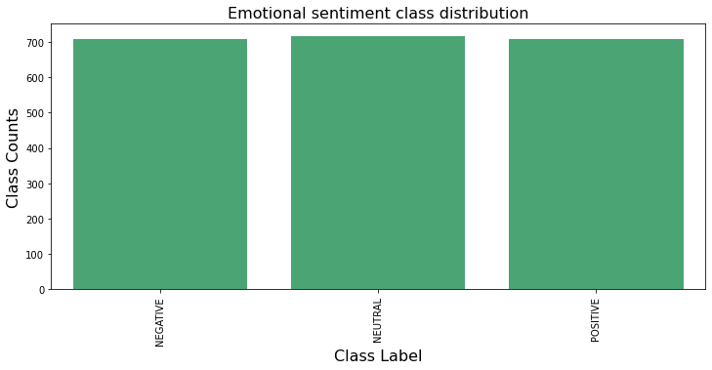
OUTPUT (Images)

Slide 11
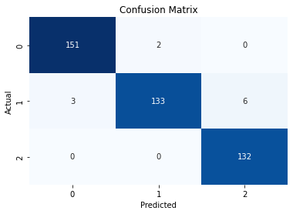
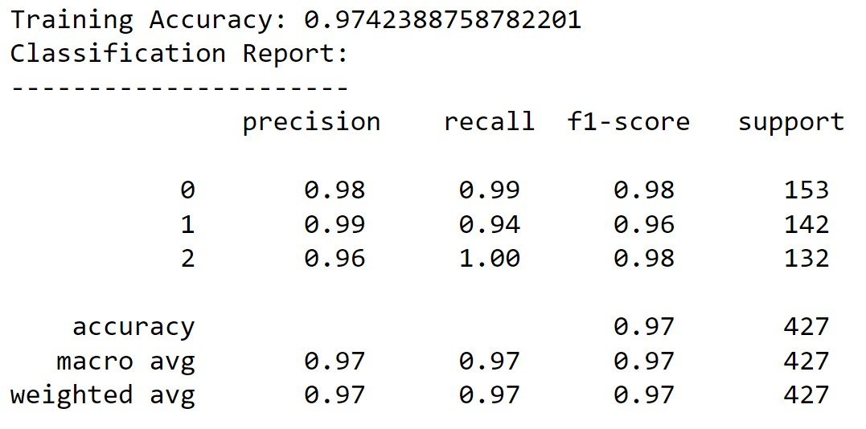
OUTPUT (Images)
Total Predicted : 427 Accuracy : 97%
Correct Predicted : 416
Wrong Predicted : 8

Slide 12
LITERATURE REVIEW
IEEE Explore , 24 June 2010
(using python for Processing & Visualization)
IEEE Explore , 28 January 2016
(Enhanced 3-Dimensional visualization of EEG signals)
IEEE Explore , 09 February 2017
(Enhanced visualization for improved real-time EEG Monitoring)

Slide 13
Thank You

